Slide 1


FARM AID
TEAM 1 :
Aaryan Saha
C Chandana
K Hema Chandana
Ved Keshattiwar
N Devesh
B Anand Kumar

Slide 2
Project Overview
FarmAid Overview:
Digital platform for farmers and agricultural businesses.
Provides flexible financial assistance for crop cultivation, equipment purchases, and land expansion.
Key Features:
Tailored loan options.
Competitive interest rates.
User-friendly application process.

Slide 3
Users of the System
Admin
Admins can oversee loan applications, and ensure compliance with financial regulations.
User
Users, primarily farmers, can access loan services, apply for financial assistance, and manage their accounts through the platform.

Slide 4
Admin Flow Diagram
Admin
Register
Login
Loan
Loan Requested
Feedbacks
Create
View
View
View
Update
Update
Delete

Slide 5
User Flow Diagram
User
Register
Login
Loan
Feedback
View Loans
Applied Loans
Create
View
View
View
Apply
Delete
Delete

Slide 6
Technology Stack
Front End:
Angular 10+, HTML, CSS.
Back End:
Java, Spring Boot, MySQL.
Authentication:
JWT (JSON Web Tokens) for secure user authentication.

Slide 7
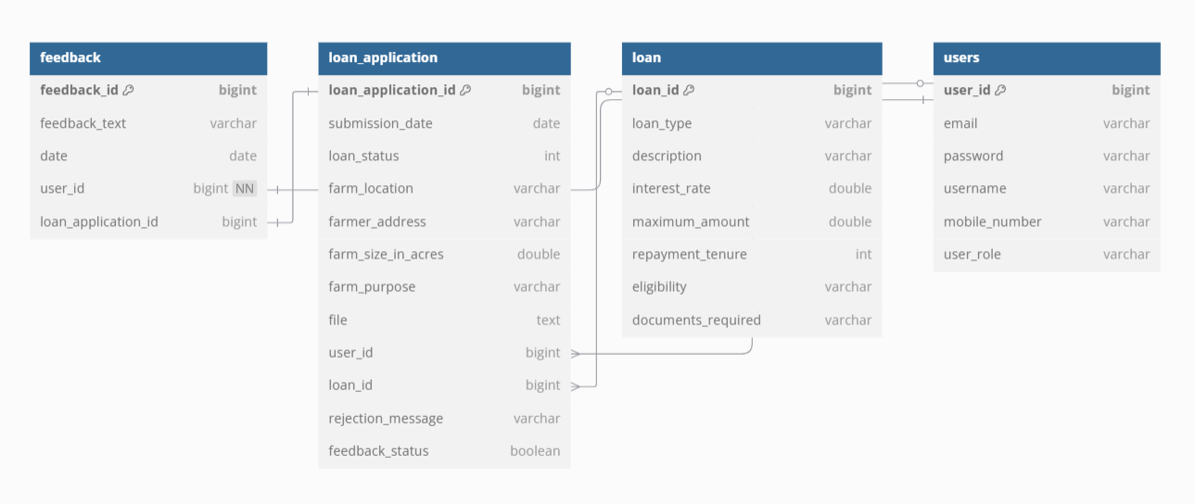
ER-Diagram

Slide 8
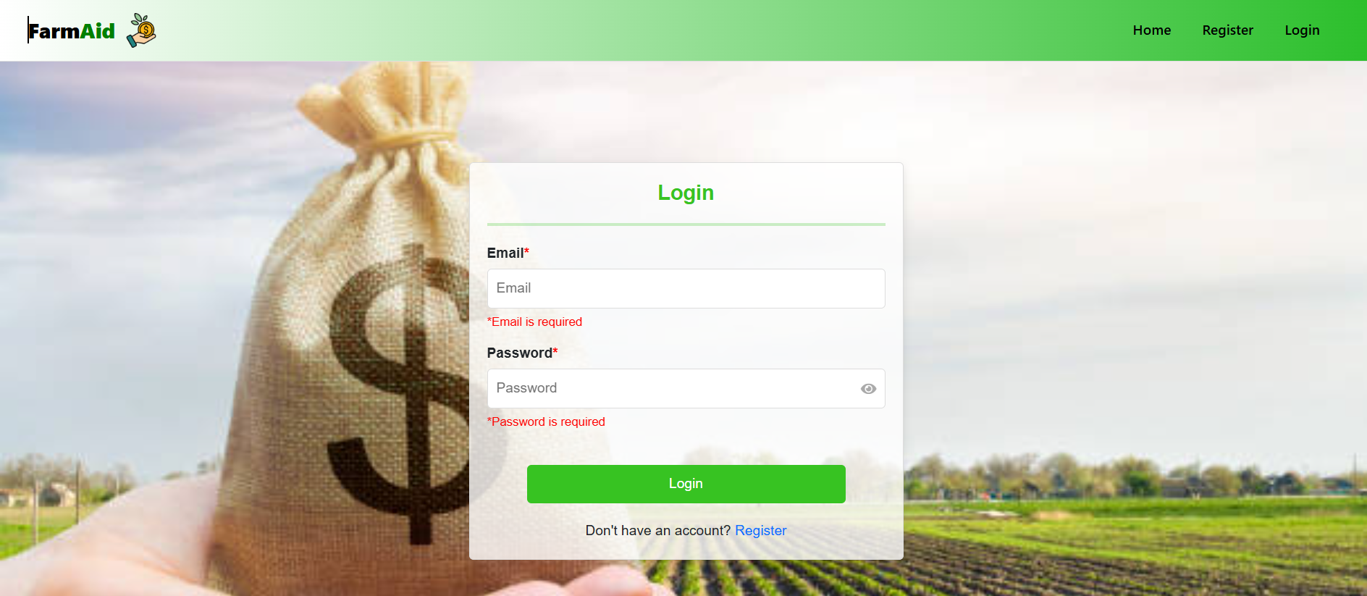
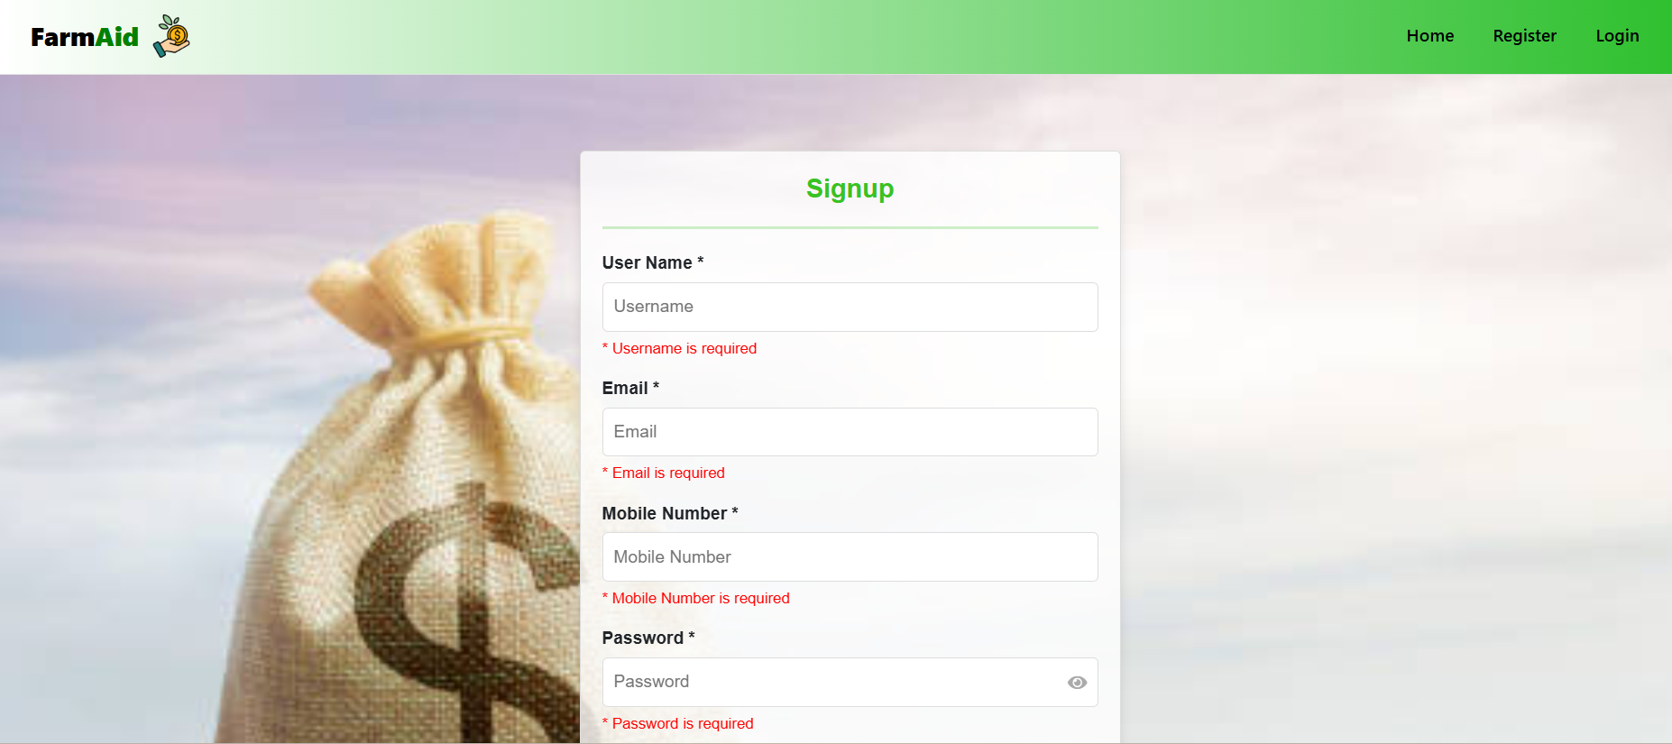

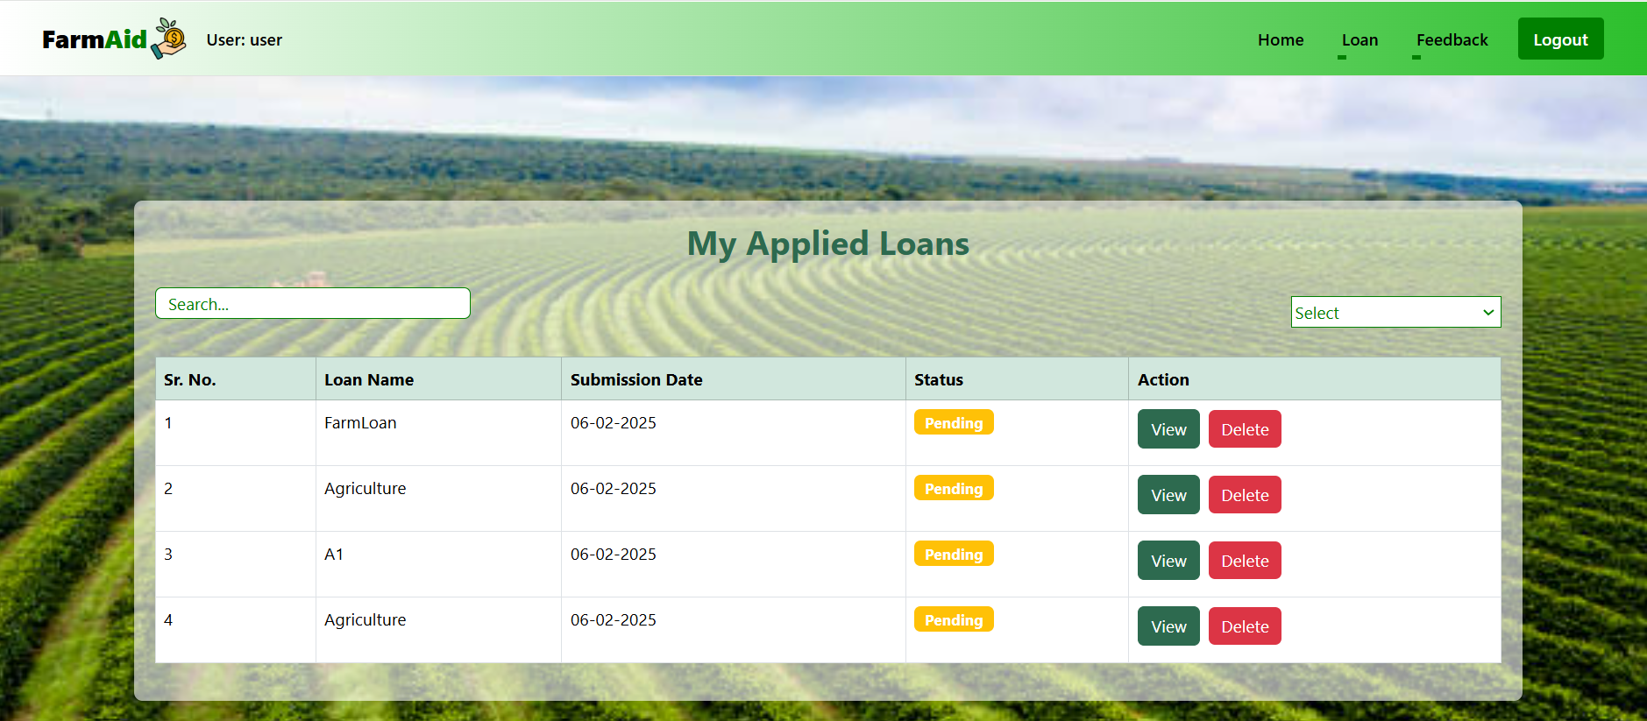
Output Screenshots

Slide 9
Conclusion
FarmAid revolutionizes financial support for farmers and agricultural businesses through a digital platform.
Provides a comprehensive selection of loan options tailored to various agricultural needs.
Empowers farmers to make informed decisions with detailed loan descriptions, competitive interest rates, and clear terms and conditions.
Ensures a seamless and user-friendly application process for easy access to financial assistance.
Supports crop cultivation, farm equipment purchases, and land expansion.
Acts as a reliable partner in fostering agricultural growth and sustainability.
Highlights the role of digital innovation in driving positive change in the agricultural sector.

Slide 10
Thank You
Batch 1

